Slide 1

KKGiSL INSTITUTE OF TECHNOLOGY
COIMBATORE
DEPARTMENT OF computer science & engineering
MINI Project phase review # 00
Implementation of the Alumni Association platform.
Team members:
711721104006 Adithayakumaar S
711721104037 Gokul P
711721104053 Kathirvelmuruganwanthan P
711721104057 Kaviyarasan R
Under the guidance of :
Mr.Vivekanandhan , AP/CSE

Slide 2

agenda
PROJECT CONCEPT AND TOPIC SELECTION
LITERATURE REVIEW AND BACKGROUND RESEARCH
RELEVANCE AND IMPACT OF PROJECT OUTCOMES
PROJECT PLANNING AND TIMELINE
METHODOLOGY AND APPROACH

Slide 3
PROJECT CONCEPT AND TOPIC SELECTION
The Alumni Association platform plans to reinforce associations among graduates and their institute of matriculation by giving a concentrated framework to graduated class enlistment, profile the executives, open positions, concentrate on materials, gifts, occasion support, and achievement following.The stage empowers consistent systems administration, professional success, and information sharing , encouraging commitment through intuitive highlights like criticism assortment and overviews .By offering an organized and open space for graduated class communications, the stage improves institutional help, proficient development, and local area building .
The topic was selected to bridge the gap between alumni and institutions by providing a centralized digital platform for networking, mentorship, job opportunities, and event management. This ensures lifelong alumni engagement, career support, and institutional growth through a structured and interactive system.

Slide 4
LITERATURE REVIEW AND BACKGROUND RESEARCH
S.No | Title of the paper | Author | Description
1 | Design and Implementation of Student and Alumni Web Portal | Shaimaa Q. Sabri, Akeela M. Ahmad, Maiwan B. Abdulrazzaq | This web portal utilizes MySQL, PHP, and AJAX with SWOT analysis to improve alumni engagement, communication, and career tracking.
2 | Implementation of a Multi-Environment Alumni Association with Location Identification | Md. Tanvir Rahman | This alumni system uses GPS tracking and Google API to enhance proximity-based connections, networking, and job opportunities.
3 | Alumni Association Portal | R. Divya, A. Thamarai Selvi. | The system enables real-time alumni interactions, event registration, job postings, and ensures data security and privacy.

Slide 5
S.No | Title of the paper | Author | Description
4 | Alumni Portal | Angha Kadve, Akash Santosh Kumbhar, Swaliha Haroon Mulla, Vishwajeet Sunil Patil, Omkar Sidhanath Sawant | This platform features chatbots, event management, networking, career services, and fundraising to enhance dynamic alumni engagement.
5 | Development of Intelligent Alumni Management System for Universities | Nayyar Ahmed Khan, Ahmed Masih Uddin Siddiqi, Mohammad Ahmad | This AI-driven alumni management system strengthens alumni relationships through job placements, mentorship programs, and feedback mechanisms.

Slide 6
RELEVANCE AND IMPACT OF PROJECT OUTCOMES
Relevance: 1.Strengthens alumni-institution connections through a web & mobile platform. 2.Facilitates career growth, mentorship, and job opportunities. 3.Encourages alumni contributions via a secure donation portal. 4.Showcases alumni achievements to inspire students. 5.Simplifies event management for reunions & networking.
Expected Outcomes: 1.Improved alumni engagement & communication. 2.Career & mentorship support for students. 3.Increased institutional reputation & funding. 4.Centralized alumni data management. 5.Secure, scalable, and automated system.

Slide 7
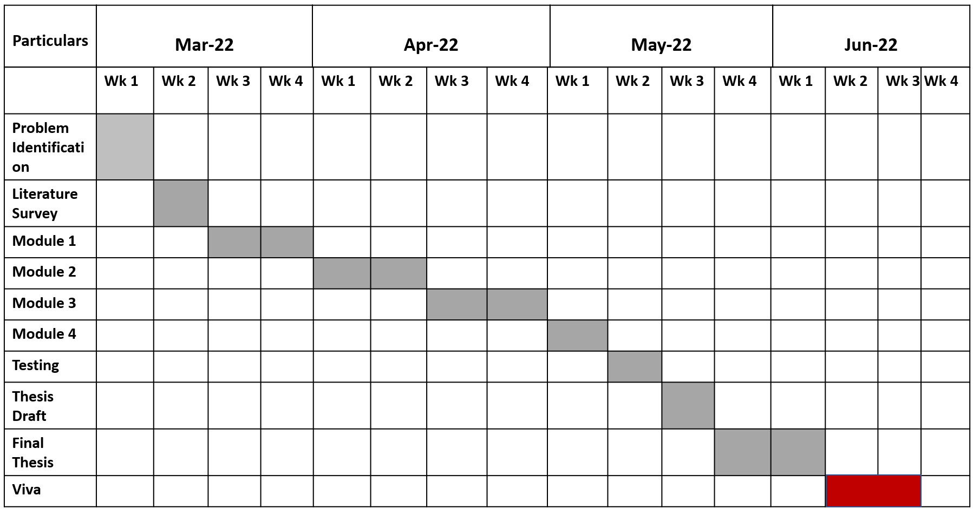
TIMELINE

Slide 8
METHODOLOGY AND APPROACH
TECHNOLOGY STACK: =>Front end- react.js(web),react.native(app) =>Backend-node.js,express.js =>Database-MongoDB. =>Authentication-Firebase auth. =>Deployment-vercel. The frontend is built using React.js (for web) and React Native (for mobile), while the backend uses Node.js with Express.js for handling API requests. MongoDB/Firebase is used as the database to store alumni profiles, job postings, and events securely. The platform integrates authentication (Firebase Auth/JWT) and cloud deployment (Vercel/Render) to ensure scalability, security, and seamless access.

Slide 9
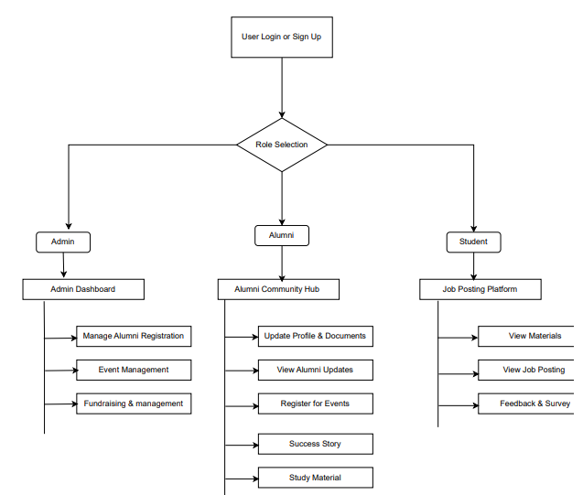
ARCHITECTURAL DIAGRAM

Slide 10
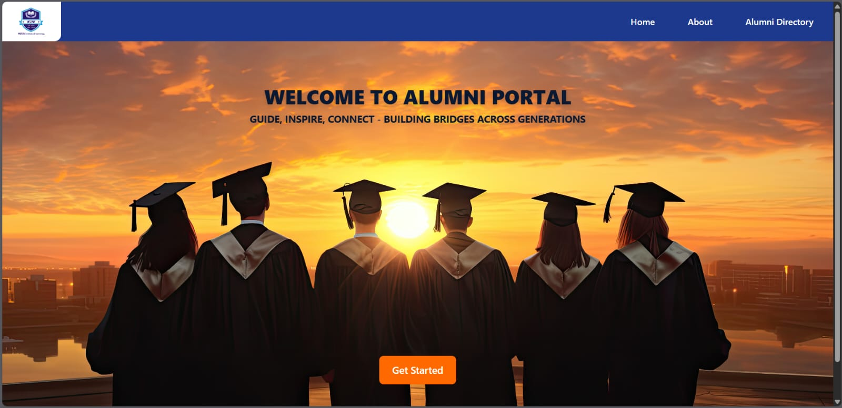
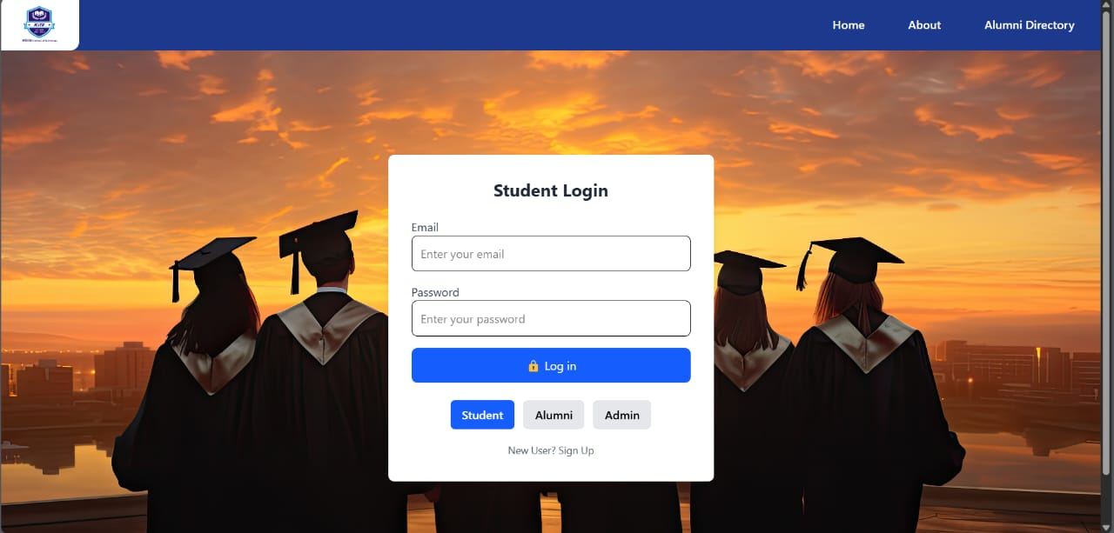

Slide 11
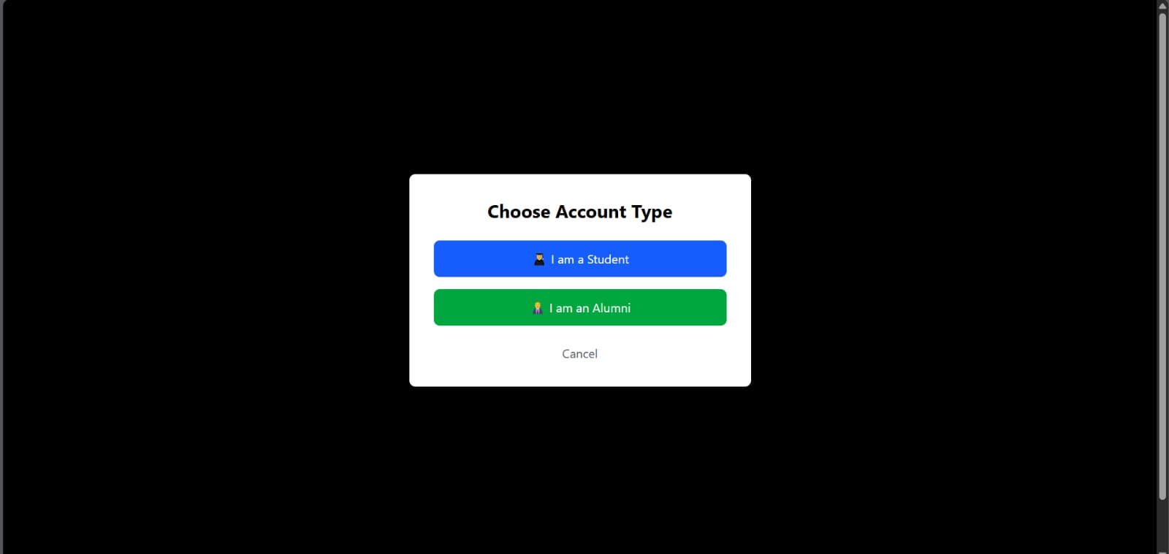
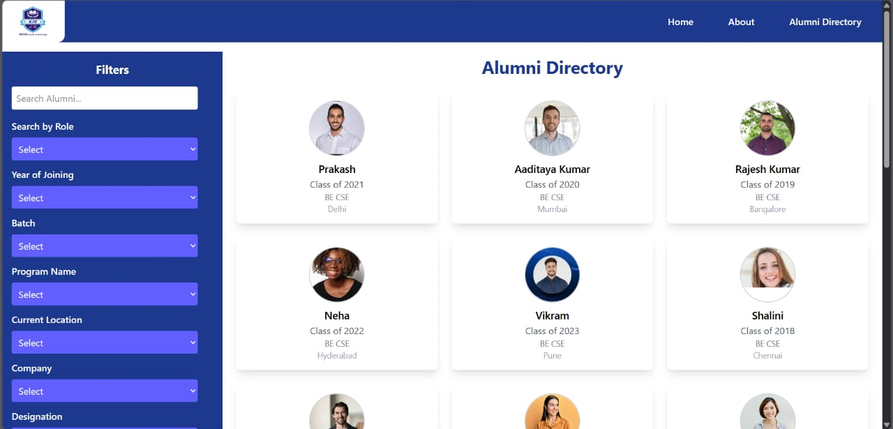

Slide 12
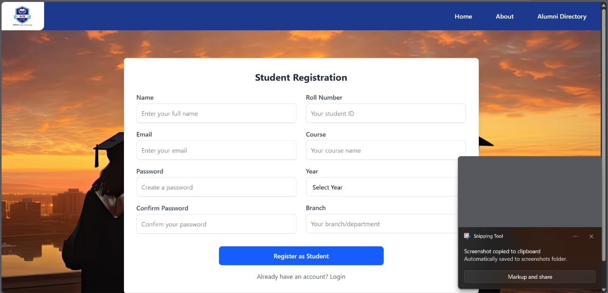
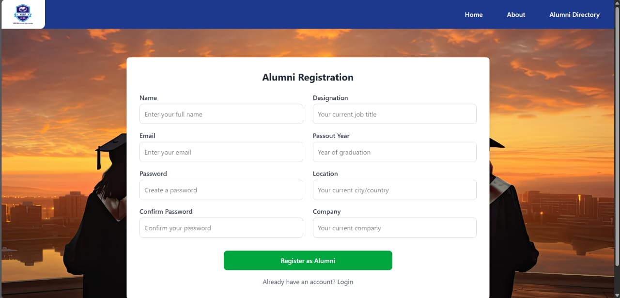

Slide 13
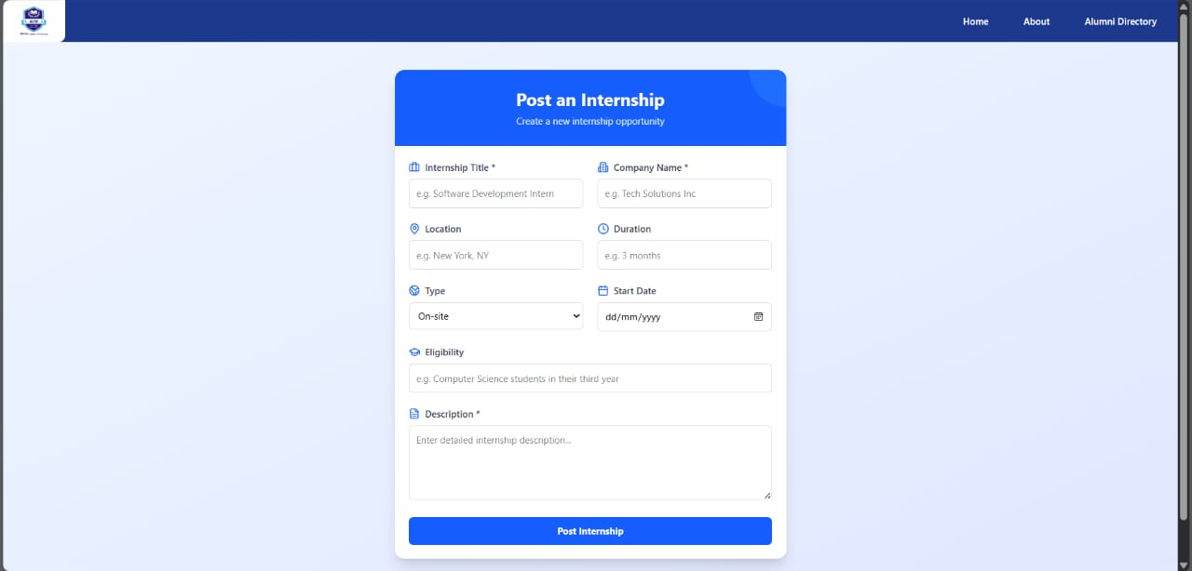
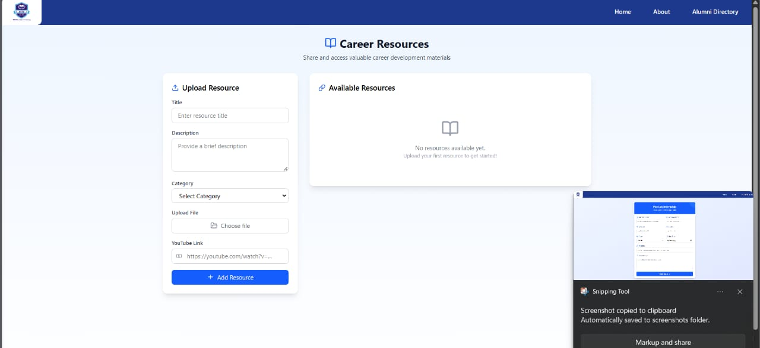

Slide 14
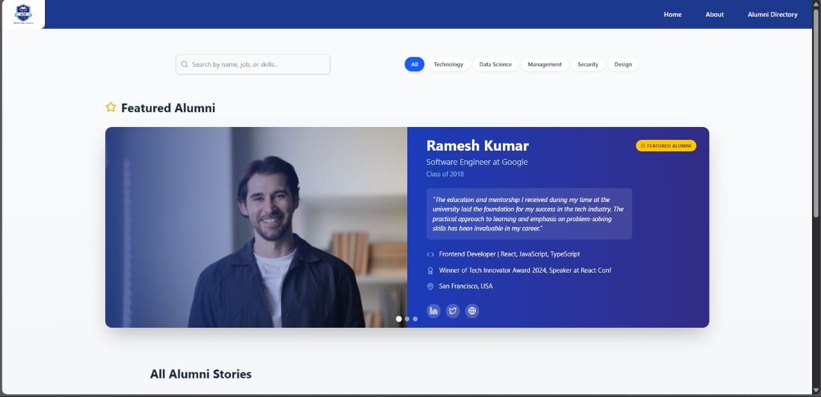
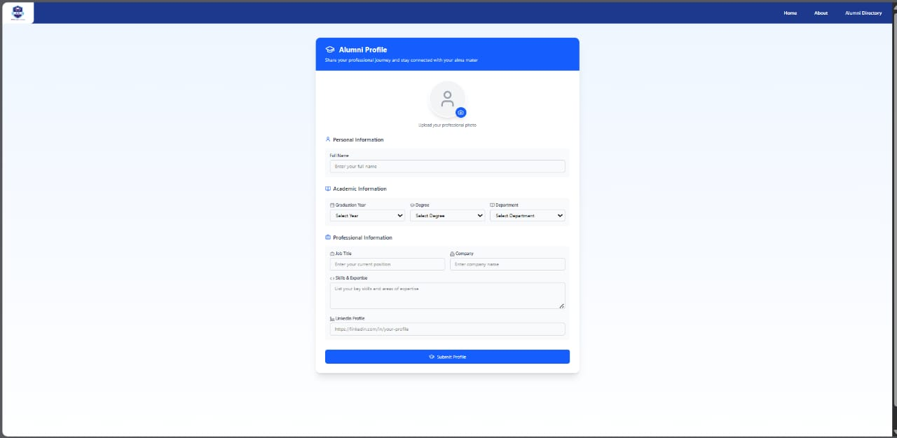

Slide 15
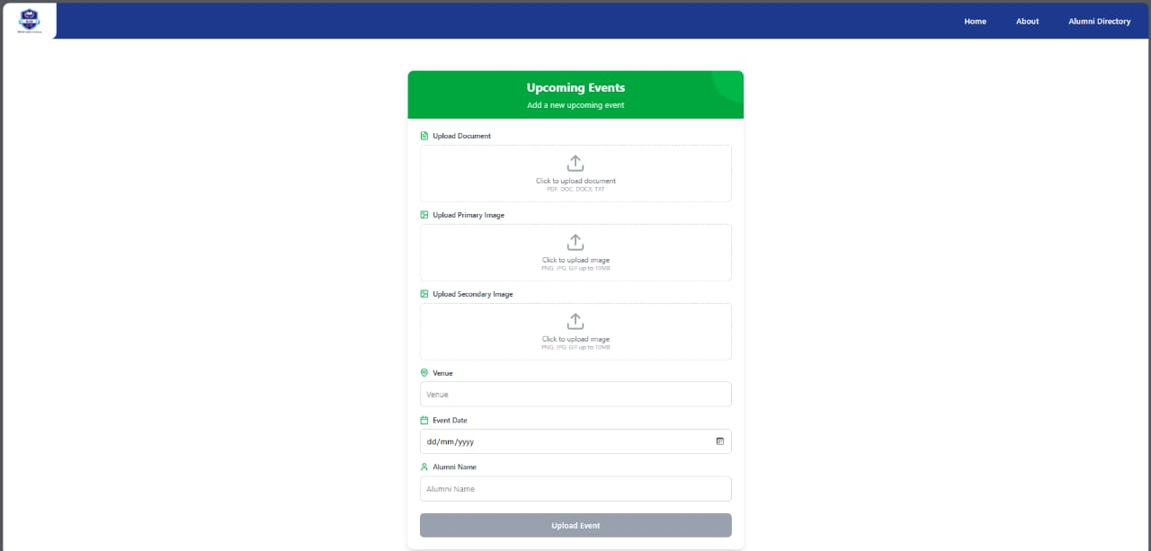
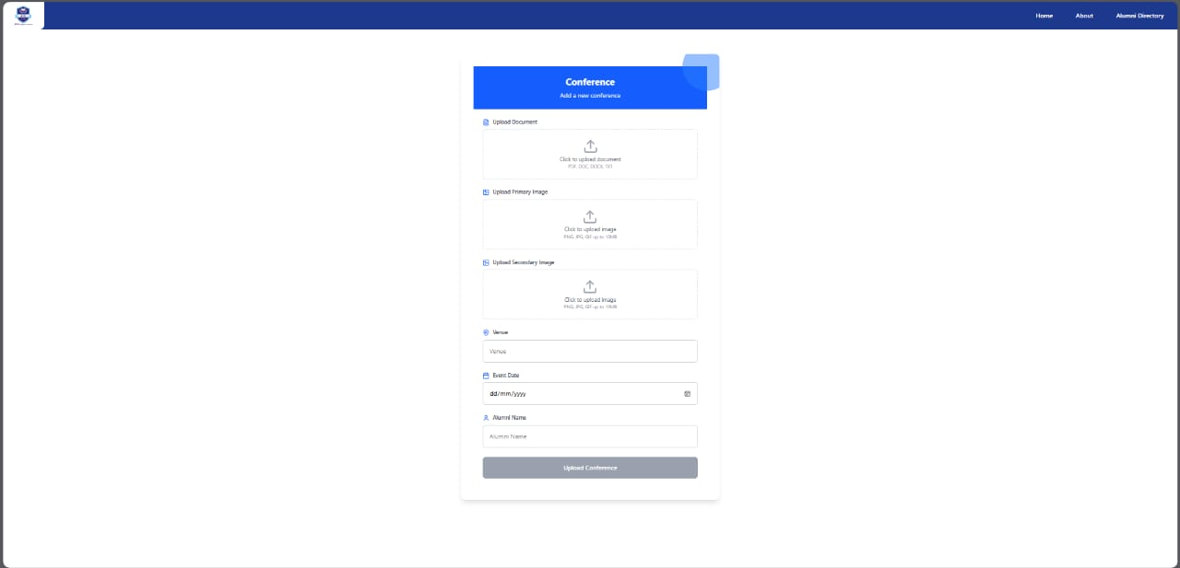

Slide 16
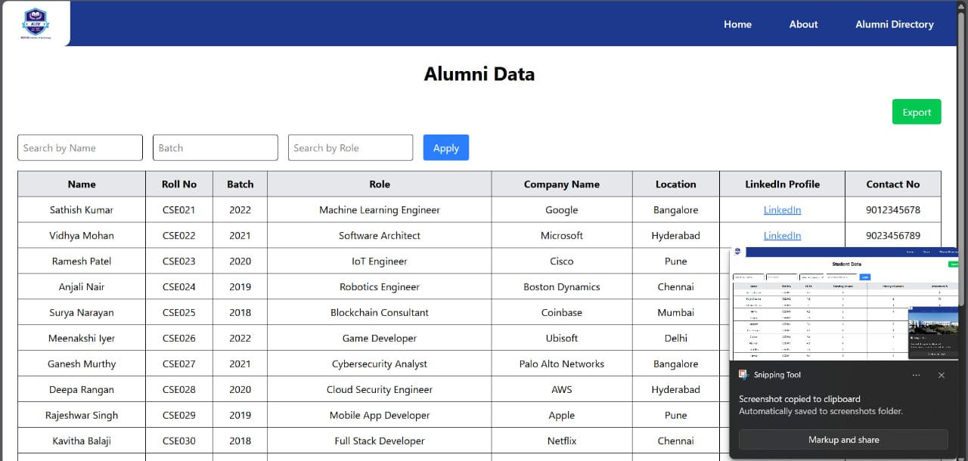
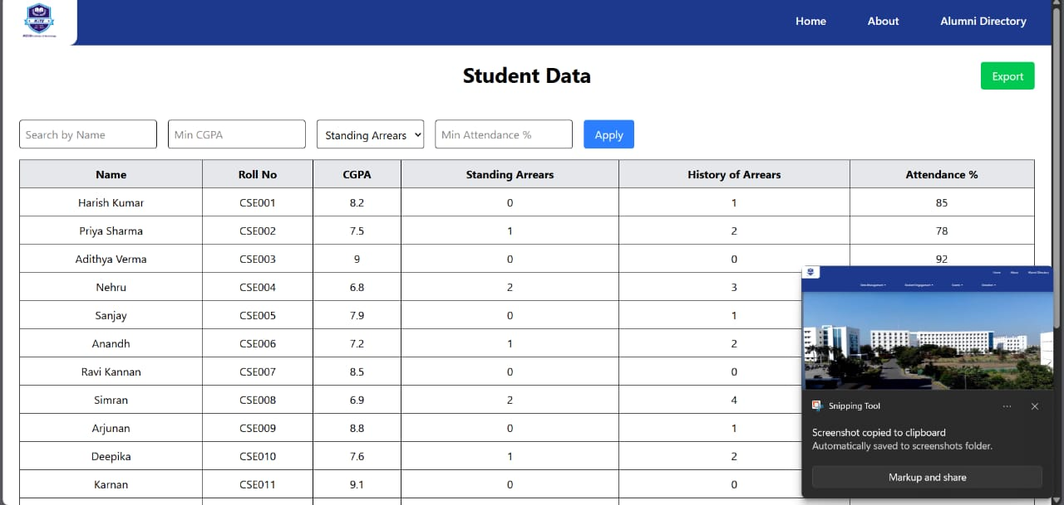

Slide 17
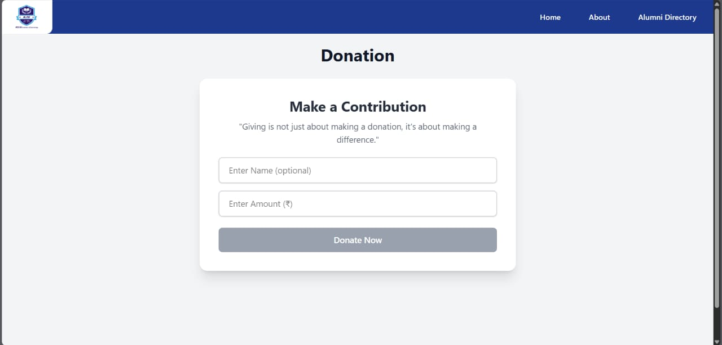
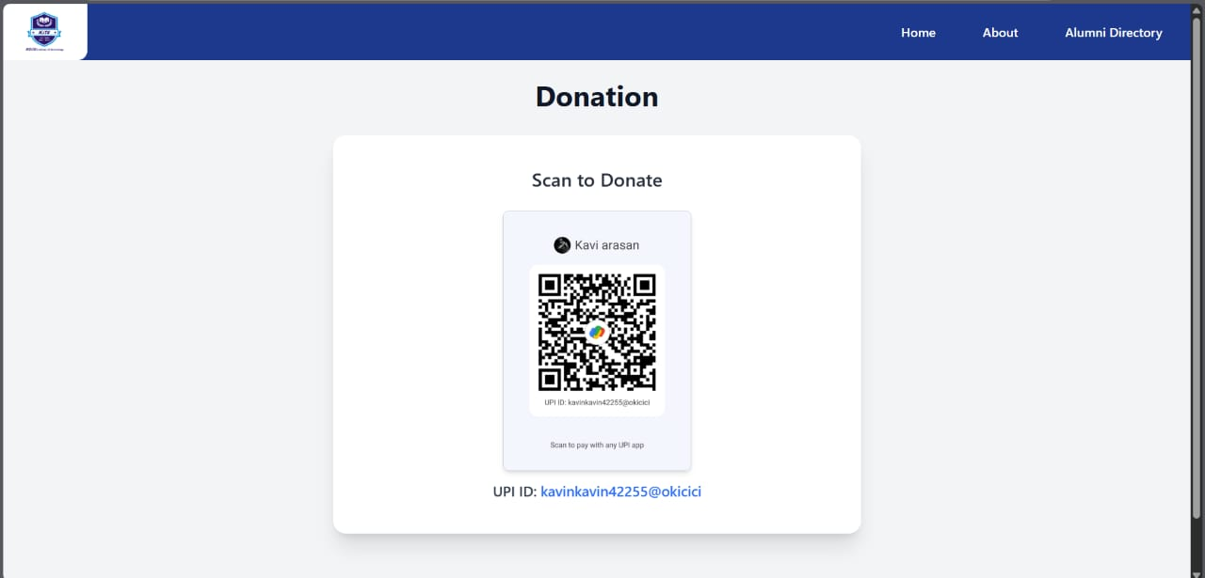

Slide 18
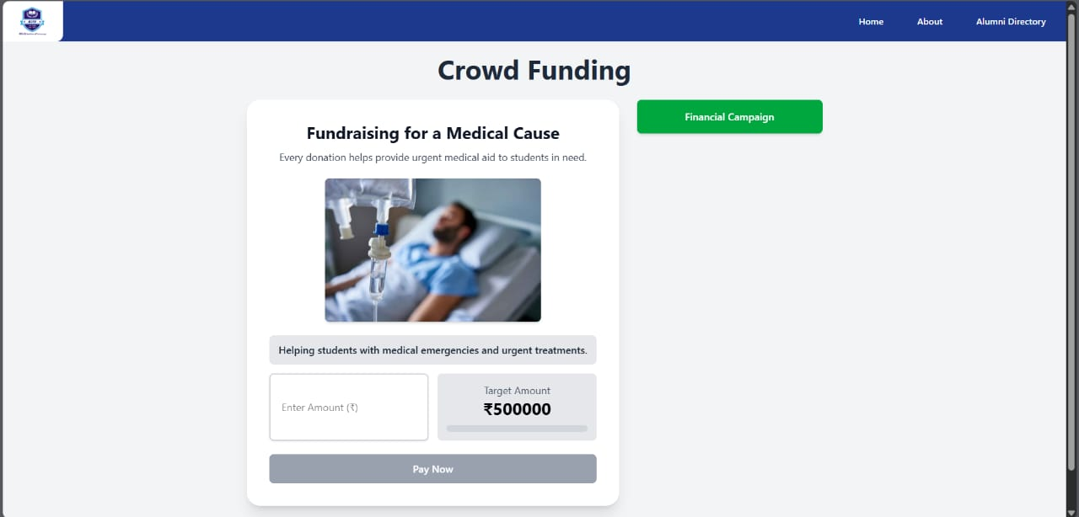
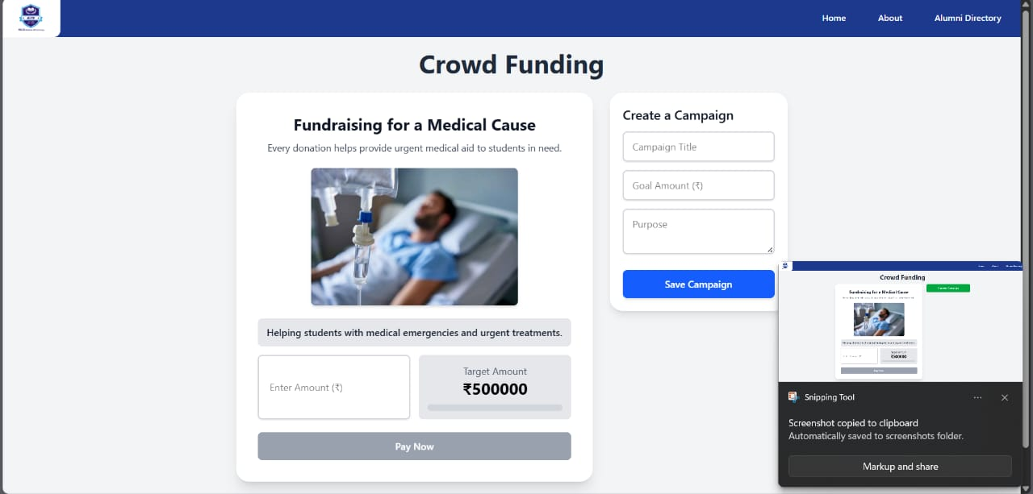

Slide 19
THANK YOU

